Slide 1
AWS Server less Analytics Data Lake
vikas

Slide 2
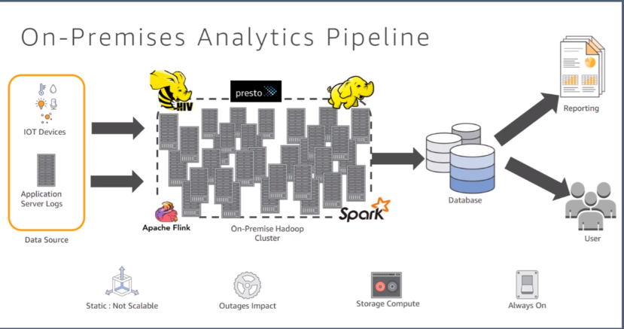
Notes:
Server less is not only lambda but this is only on the application side .
Server less ETL ,Server less Analytics , Server less reporting are different flavors .
Server less means :
No server to provision or manage. Concentrate on your business logic alone .
Scales with usage
Never pay for idle
Highly available and fault tolerant .
Not scalable and fault tolerant -- > on-premises
Storage and compute are fully compact not isolated .
Capex and opex is always there .

Slide 3
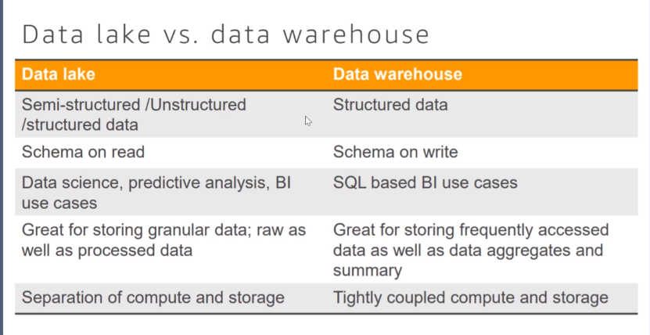
Notes:
Need of data lake :
Exponential growth of data
Diversified consumers
Multiple access mechanism
Collect data fast manner and store it centrally .
Decouple storage and compute
Store and collect any data at any scale and at low cost .
Data security and prevent unauthorized access.
Catalogue ,search and discover data
Decouple storage and compute
Future proof against highly changing complex ecosystem .
Handles Relational as well as non-relational data
Schema defined during analysis
Diversified analytical engines to gain insight .
Low cost storage and analysis can be done without data transformation too .

Slide 4
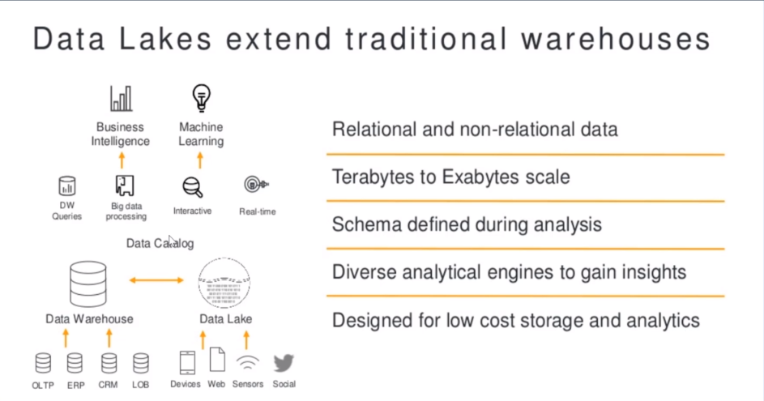
Notes:
The idea is simple: instead of placing data in a purpose-built data store, you move it into a data lake in its original format. This eliminates the upfront costs of data ingestion, like transformation. Once data is placed into the lake, it's available for analysis by everyone in the organization."

Slide 5
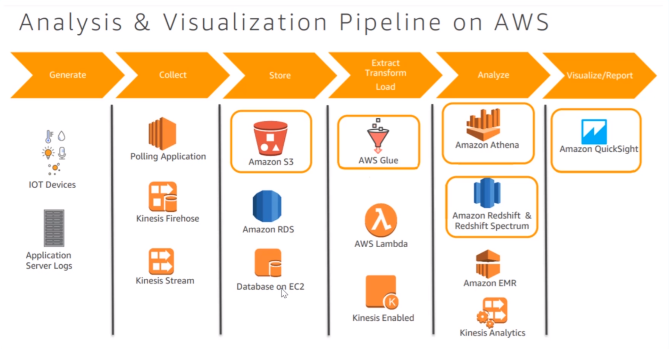
Notes:
Data Lake services :
Sources ( Web event + Product event + Email + Enterprise system + Social + Telemetry)
Ingest (Stream + Batch + upload )
Prepare ( Cleanse + Transform + Account )
Organize ( Secure + Store + Govern )
Discover ( Explore + Search + Visualize )
Users (Management team + business/Marketing/product analyst + Analytical Applications )
You can do :
Data Processing
Data Warehousing
Reporting
Real time Processing
Predictive analysis

Slide 6
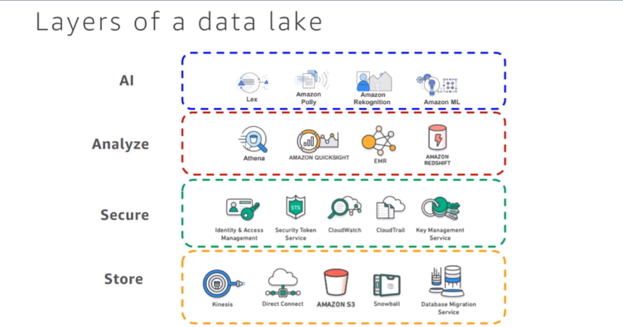

Slide 7
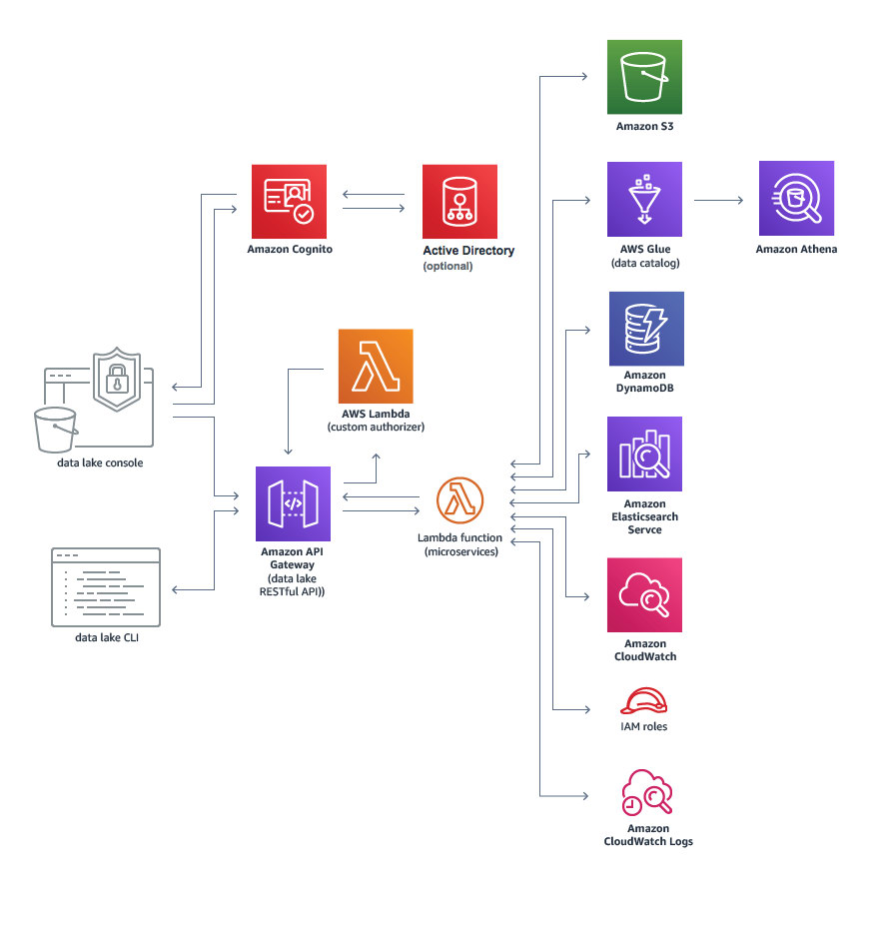
Notes:
Data Lake on AWS :
https://aws.amazon.com/solutions/data-lake-solution/
CODE : https://s3.amazonaws.com/solutions-reference/data-lake-solution/latest/data-lake-deploy.template
https://github.com/awslabs/aws-data-lake-solution

Slide 8
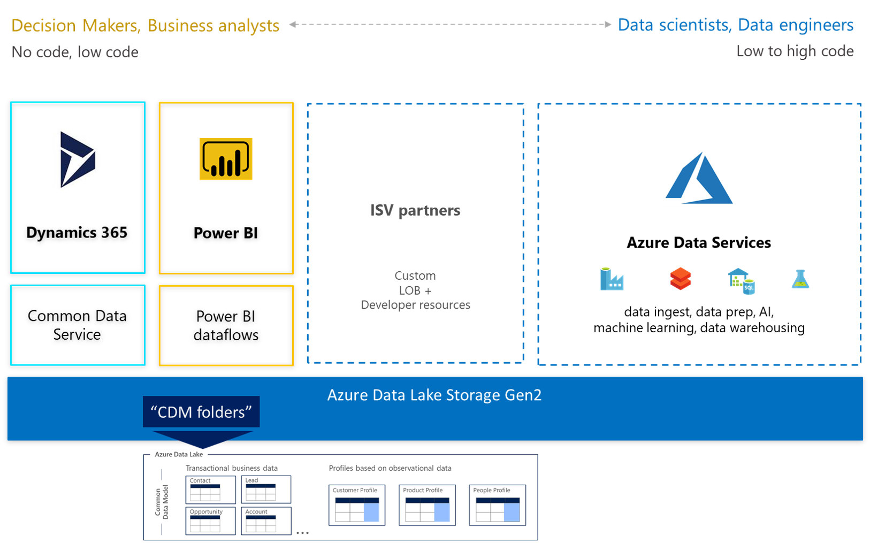
Notes:
Microsoft Azure ADLS Gen 2
Microsoft offers dedicated objective storage for Data Lakes. It seems to be a mature solution with the support of various components either created by Microsoft or of well know services (HDInsight, Spark, U-SQL, WebHDFS).
In 2018 Microsoft introduced it’s the second generation of data lake implementation called ADLS Gen2. ADLS Gen2 is the combination of the Microsoft Data Lake solutions and Blob storage.
ADLS Gen2 has all the features of both, which means it will have features such as limitless storage capacity, support all Blob tiers, Azure Active Directory integration, hierarchical file system, and read-access geo-redundant storage.

Slide 9
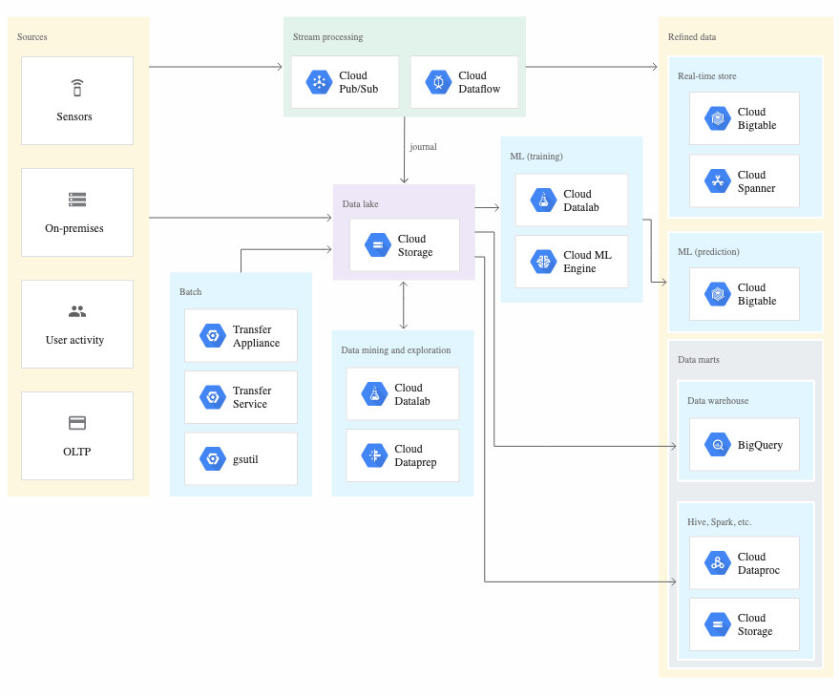
Notes:
Google Cloud
The equivalent of Amazon S3 in GCP is Google Cloud storage. Similar to S3, it offers unlimited capacity and several nines annual durability (99.999999999%).
Google highly promotes it's Machine Learning capabilities. While it has the less build in services than Microsoft and AWS it still may be a good option, especially if you already have data processing pipelines in place.
https://cloud.google.com/solutions/build-a-data-lake-on-gcp#data_ingestion

Slide 10
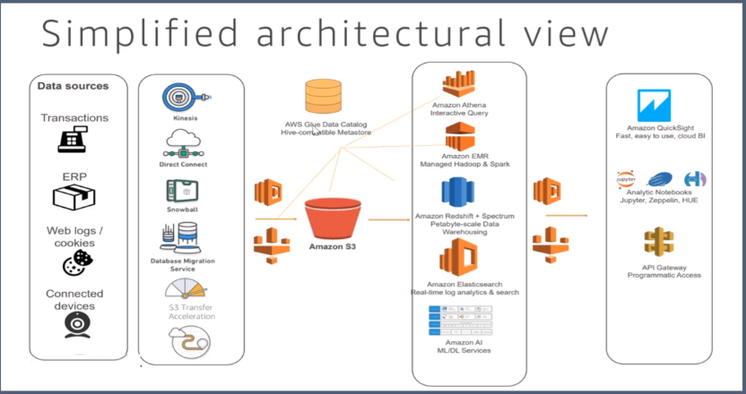

Slide 11
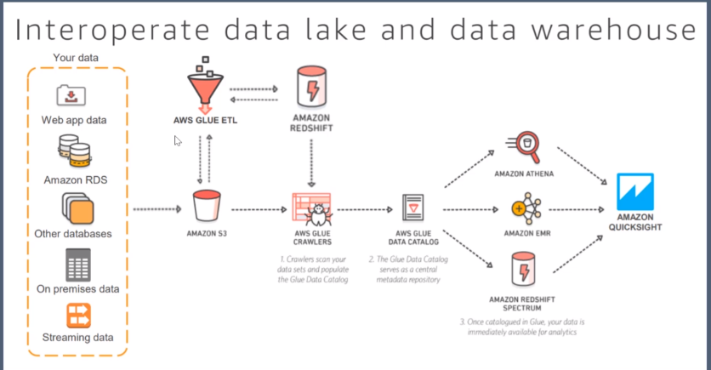

Slide 12
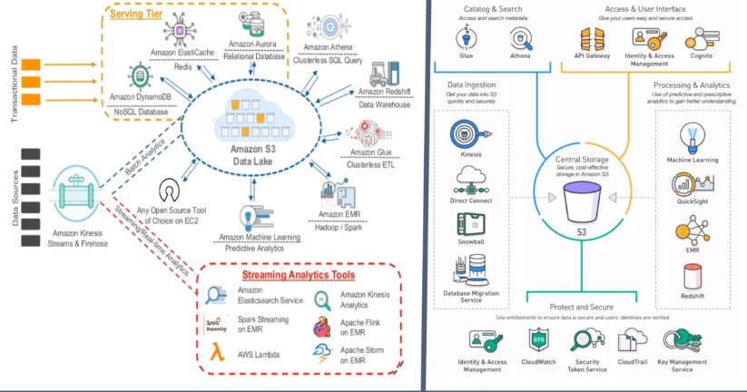

Slide 13
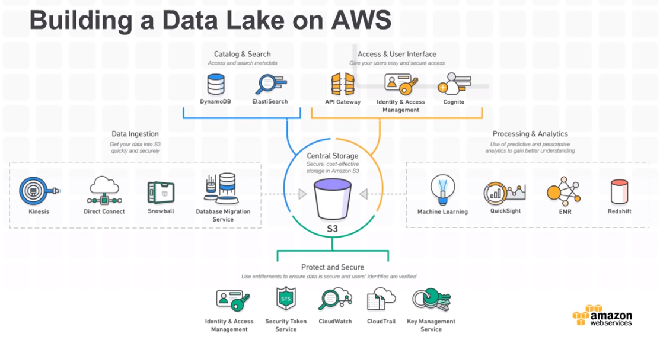

Slide 14
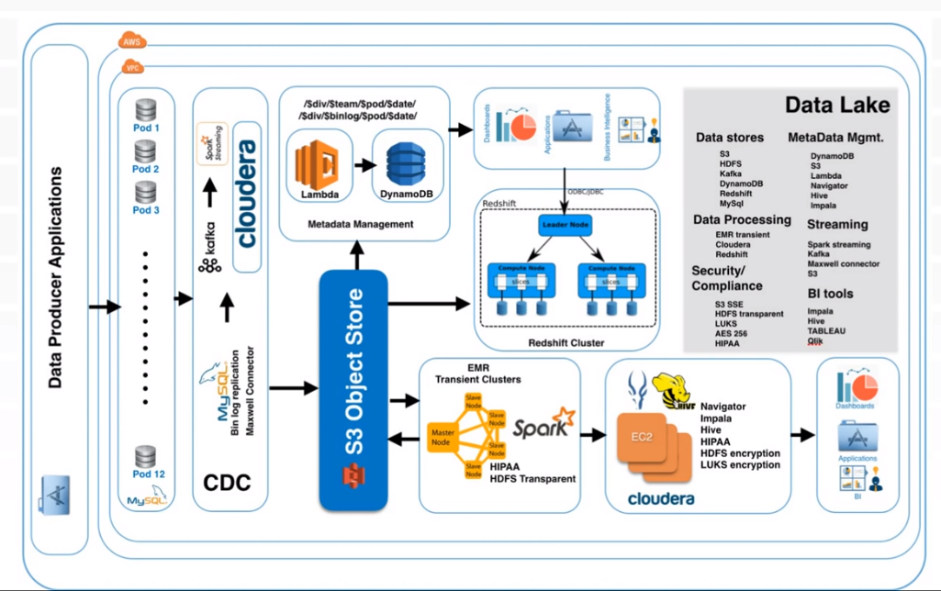

Slide 15
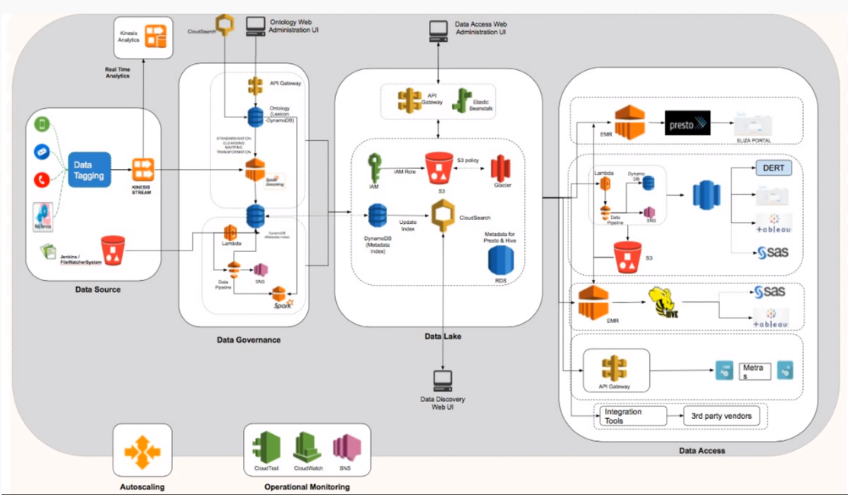

Slide 16
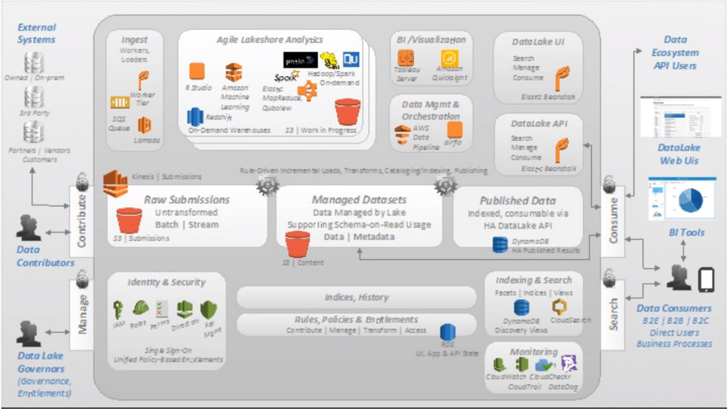

Slide 17
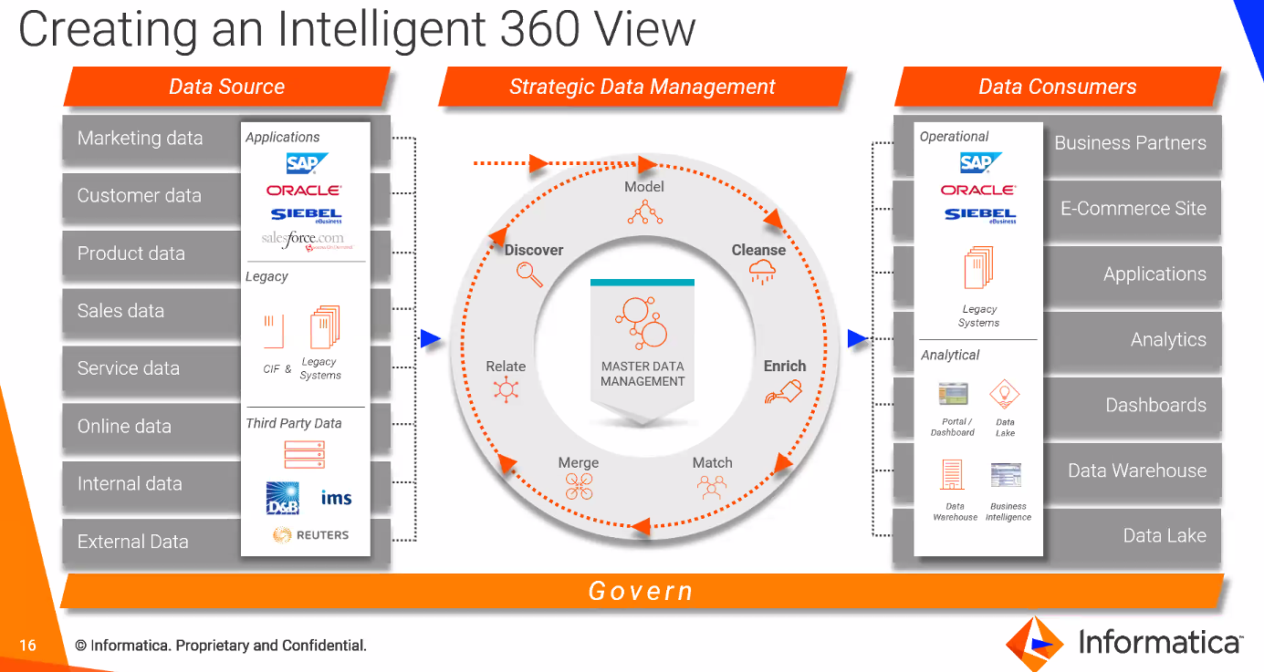

Slide 18
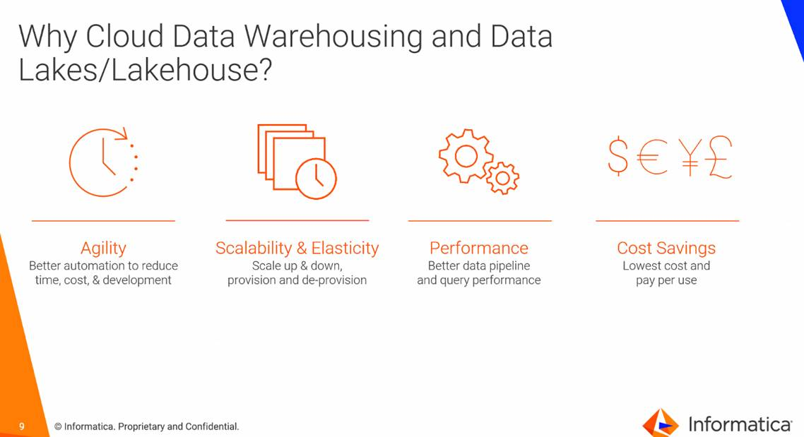

Slide 19
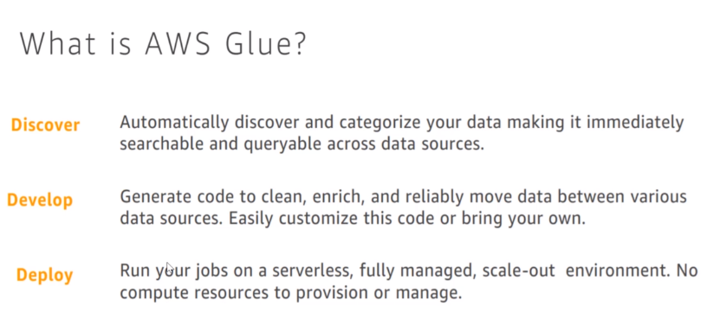
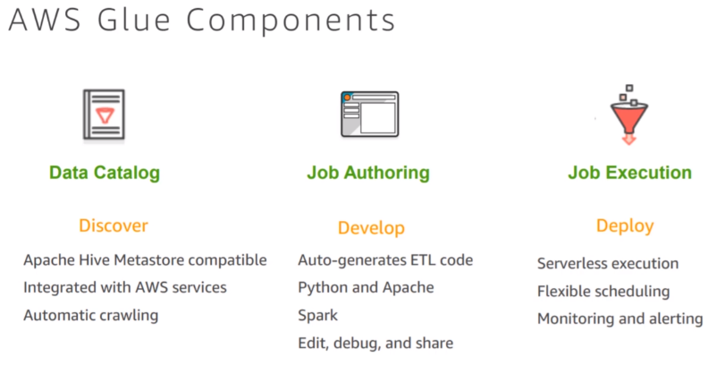

Slide 20
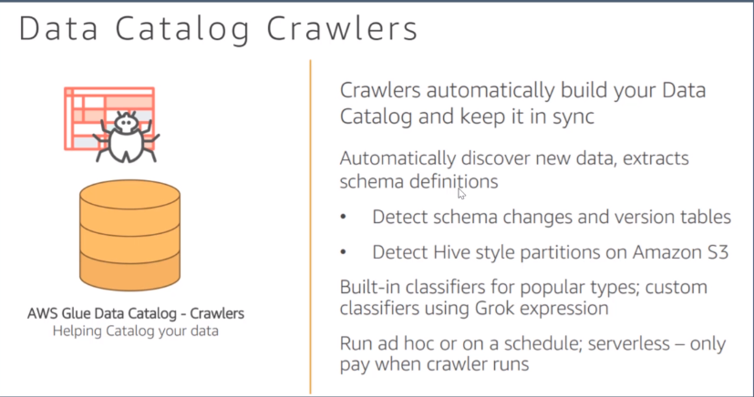

Slide 21
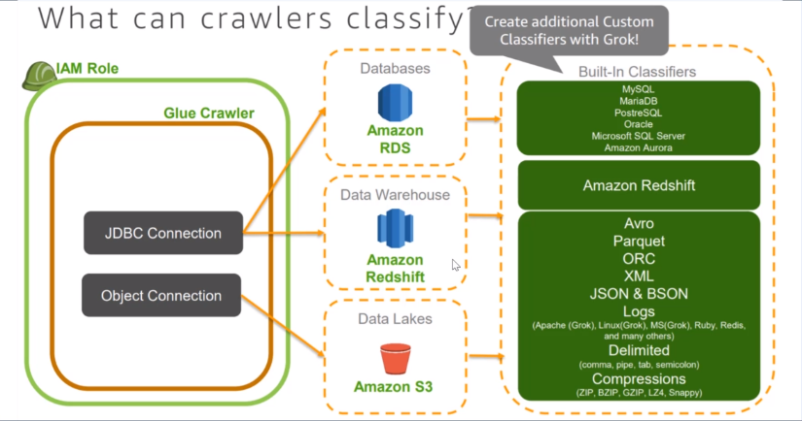

Slide 22
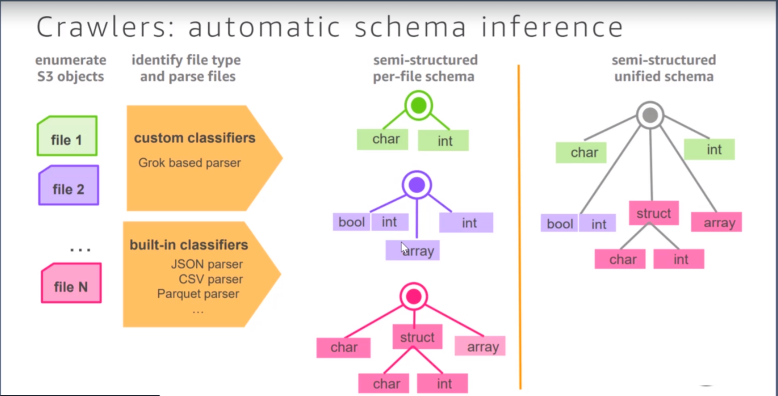
Notes:
Create a role for red-shift with AmazonDMSRedShiftS3Role and AmazonRedShiftFullAccess .

Slide 23
